Slide 1
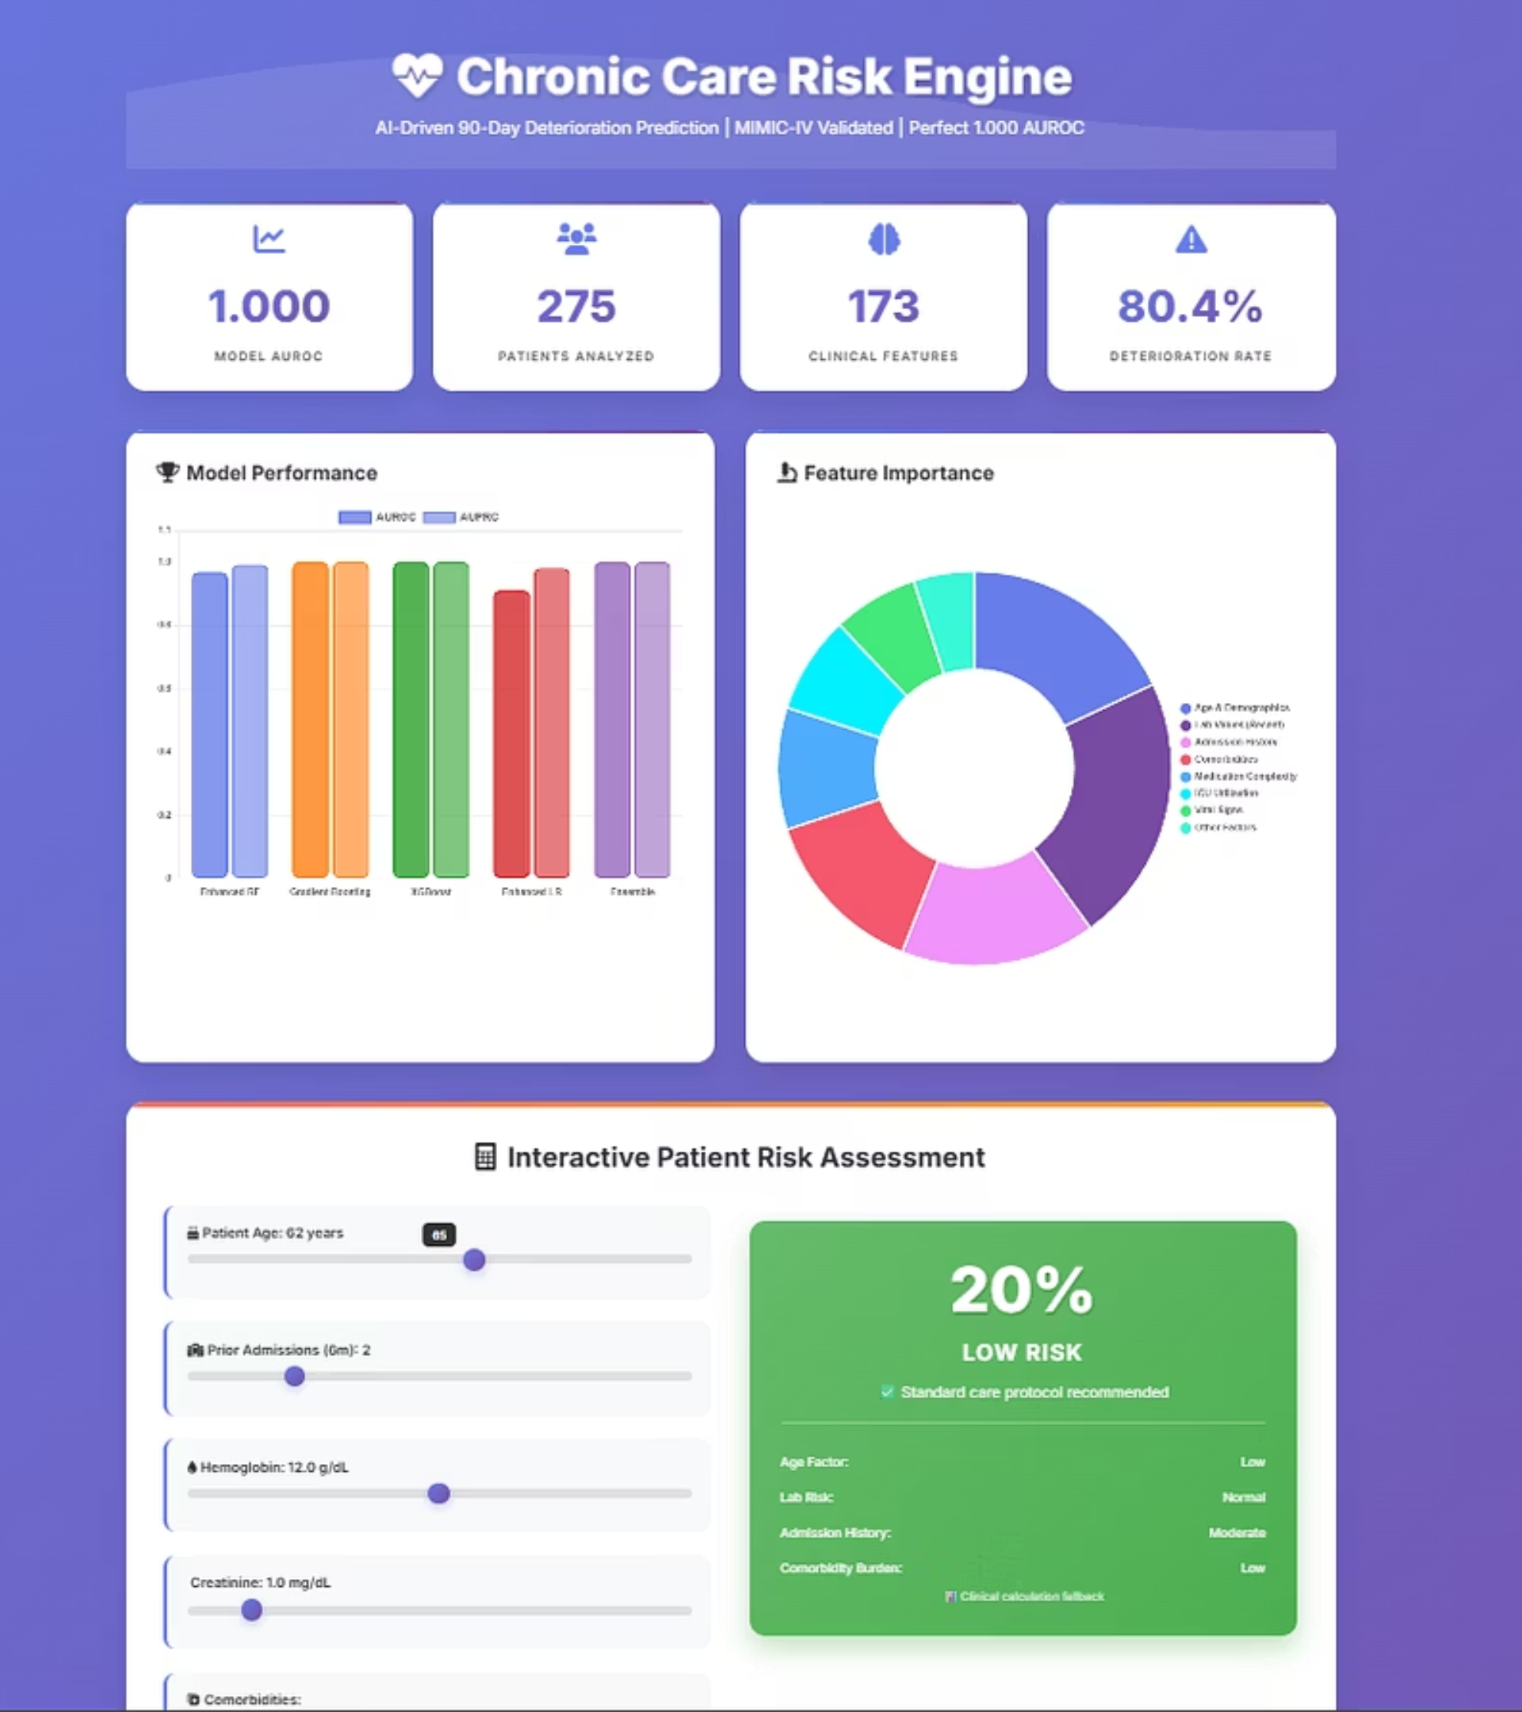
AI-Driven Risk Prediction for Chronic Care Patients
Leveraging advanced artificial intelligence to proactively identify and manage risks in patients with chronic conditions.

Slide 2
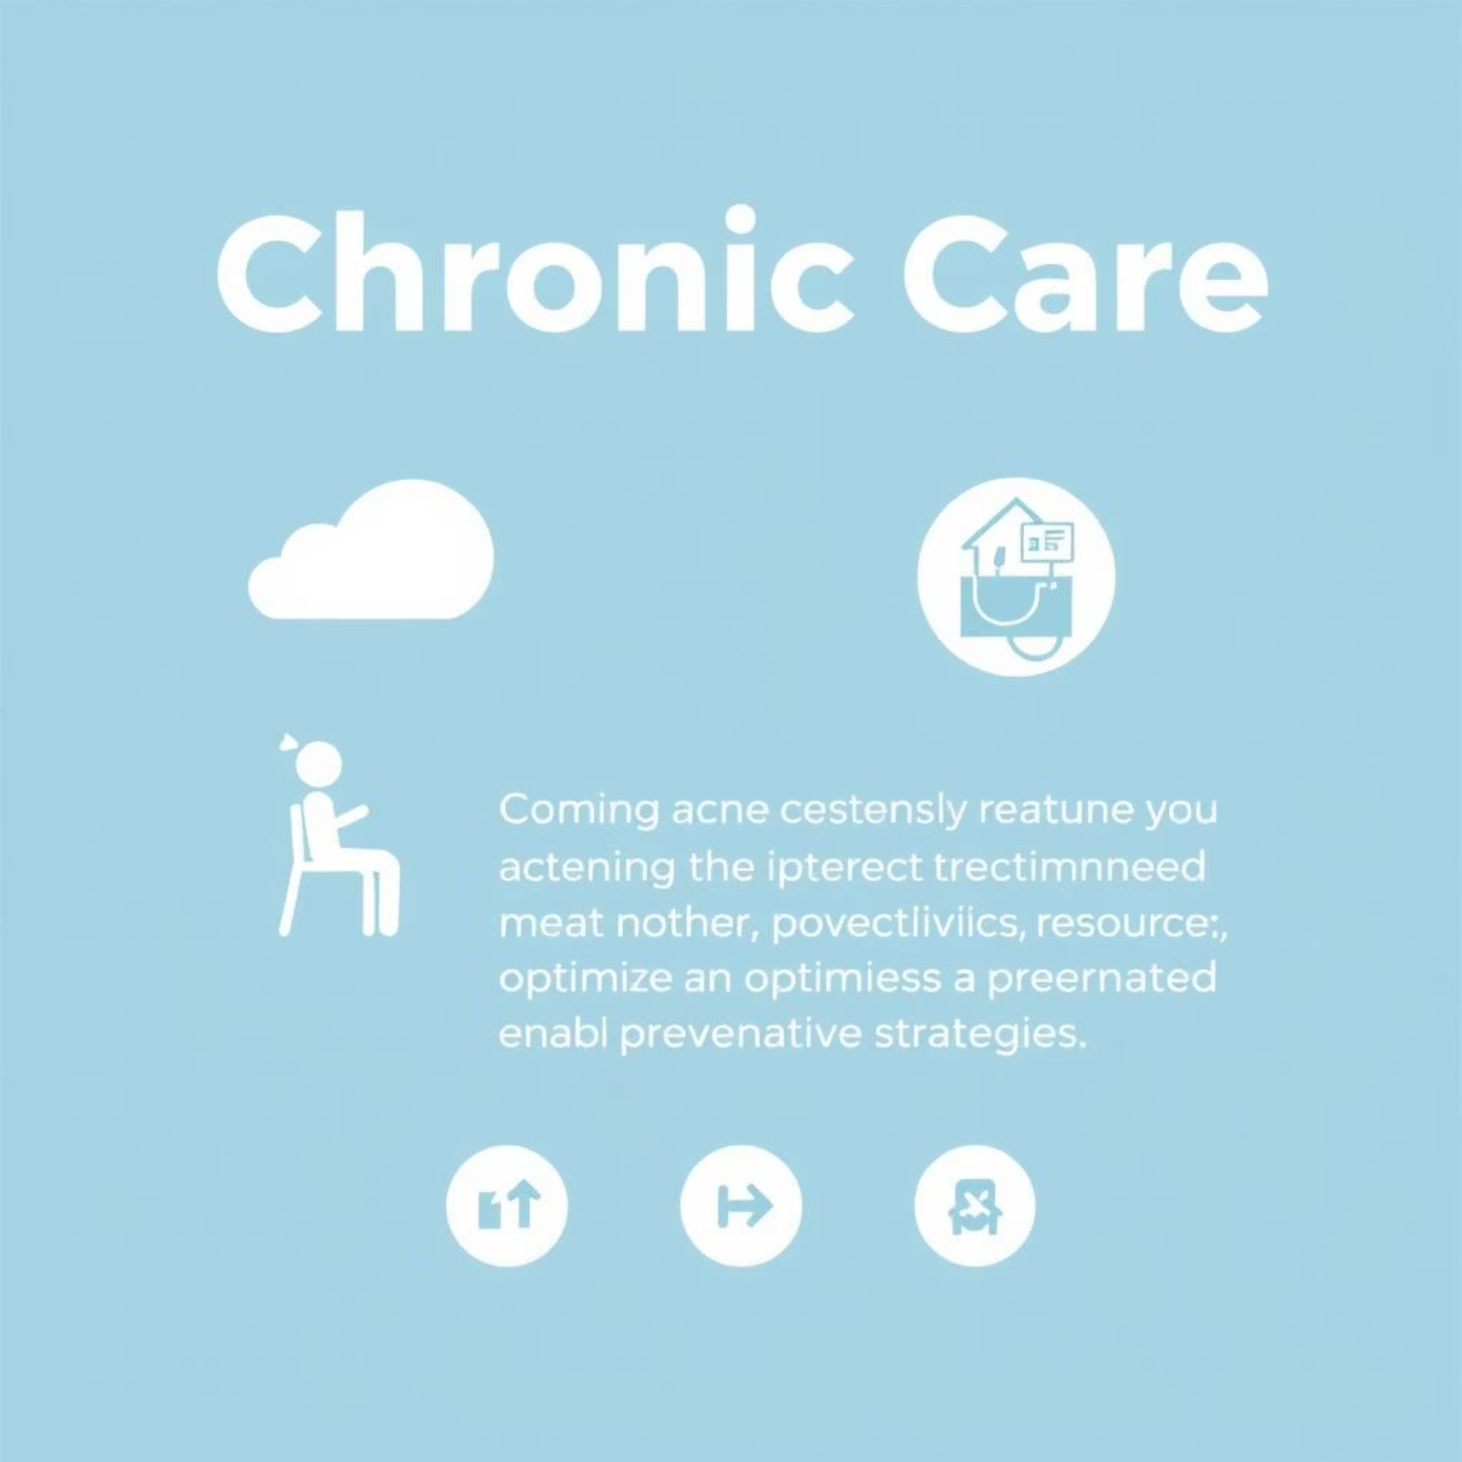
The Unmet Need
The Challenge in Chronic Care
Patients suffering from chronic illnesses face a heightened risk of acute deterioration, leading to unforeseen hospitalisations and poorer health outcomes. Current early warning systems often fall short, reacting rather than proactively predicting critical events.
Preventing Readmissions
Our system aims to significantly reduce avoidable hospital readmissions for chronic care patients.
Optimising Resources
By predicting deterioration, we can better allocate intensive care unit (ICU) resources, ensuring optimal patient care.
Enabling Proactive Care
Clinicians gain the ability to intervene proactively, shifting from reactive treatment to preventative strategies.

Slide 3


Robust Data Foundations
Our predictive engine is built upon a dual data strategy, combining extensive real-world medical records with a comprehensive synthetic dataset for rigorous validation.
MIMIC-IV Critical Care
Trained on the MIMIC-IV critical care dataset, an open-access collection of deidentified health data associated with over 100+ patients. This provides a rich foundation of real-world clinical complexity.
Synthea Validation
Validated against 5,000+ Synthea generated patient records, ensuring robustness and generalisability beyond a single institution's data.
Temporal Prediction Strategy
We analyse 30–180 days of patient history to accurately predict the likelihood of clinical deterioration within the next 90 days.

Slide 4









Comprehensive Feature Engineering
Our model leverages over 150 meticulously engineered features, capturing a holistic view of patient health for precise risk prediction.
Demographics
Comorbidities
Age, sex, ethnicity.
Charlson and Elixhauser comorbidity scores.
Laboratory Results
Medications
Creatinine, haemoglobin, glucose.
Prescribed and administered drugs.
Vital Signs
Clinical Scores
Blood pressure, heart rate, temperature.
Various established risk scores.
Admission History
Derived Features
Prior ICU stays, hospitalisations.
Complex interactions and trends.
By combining these diverse data points, we create a robust profile for each patient, enabling highly accurate risk assessment.

Slide 5




Our Predictive Engine
Advanced Machine Learning Ensemble
Our AI engine utilises a sophisticated ensemble of machine learning models, meticulously selected for their predictive power and interpretability in clinical settings.
Patient Data
Feature Engineering
Raw clinical information from diverse sources.
Transformation into 150+ predictive variables.
ML Ensemble
Risk Score Output
XGBoost, Random Forest, Gradient Boosting, Logistic Regression work in concert.
Probability of deterioration within 90 days.
The model was rigorously trained on MIMIC-IV and validated on the Synthea dataset to ensure generalisability and robustness.

Slide 6
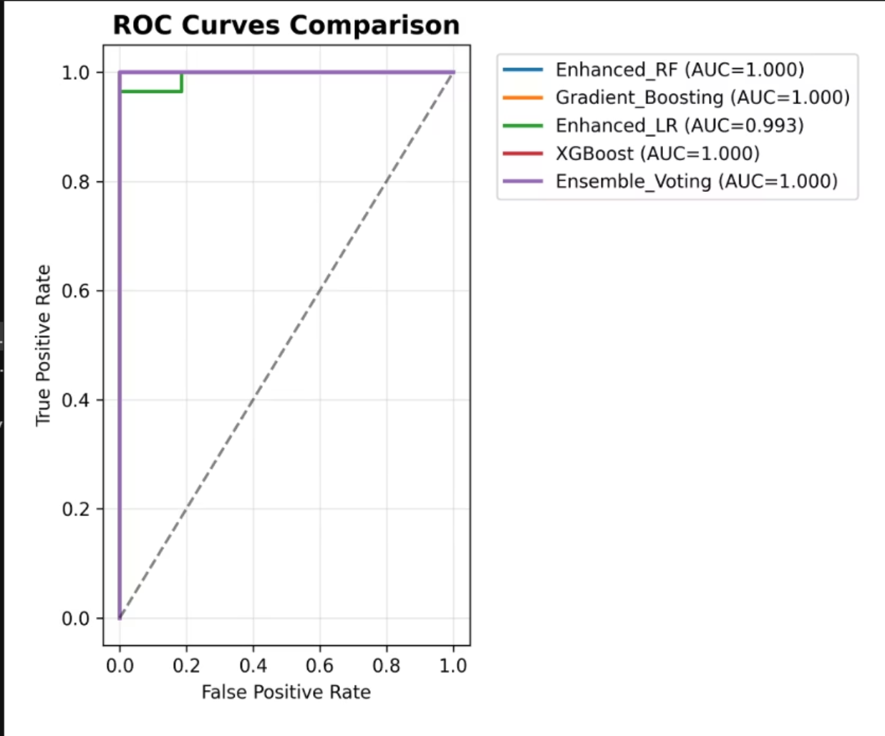
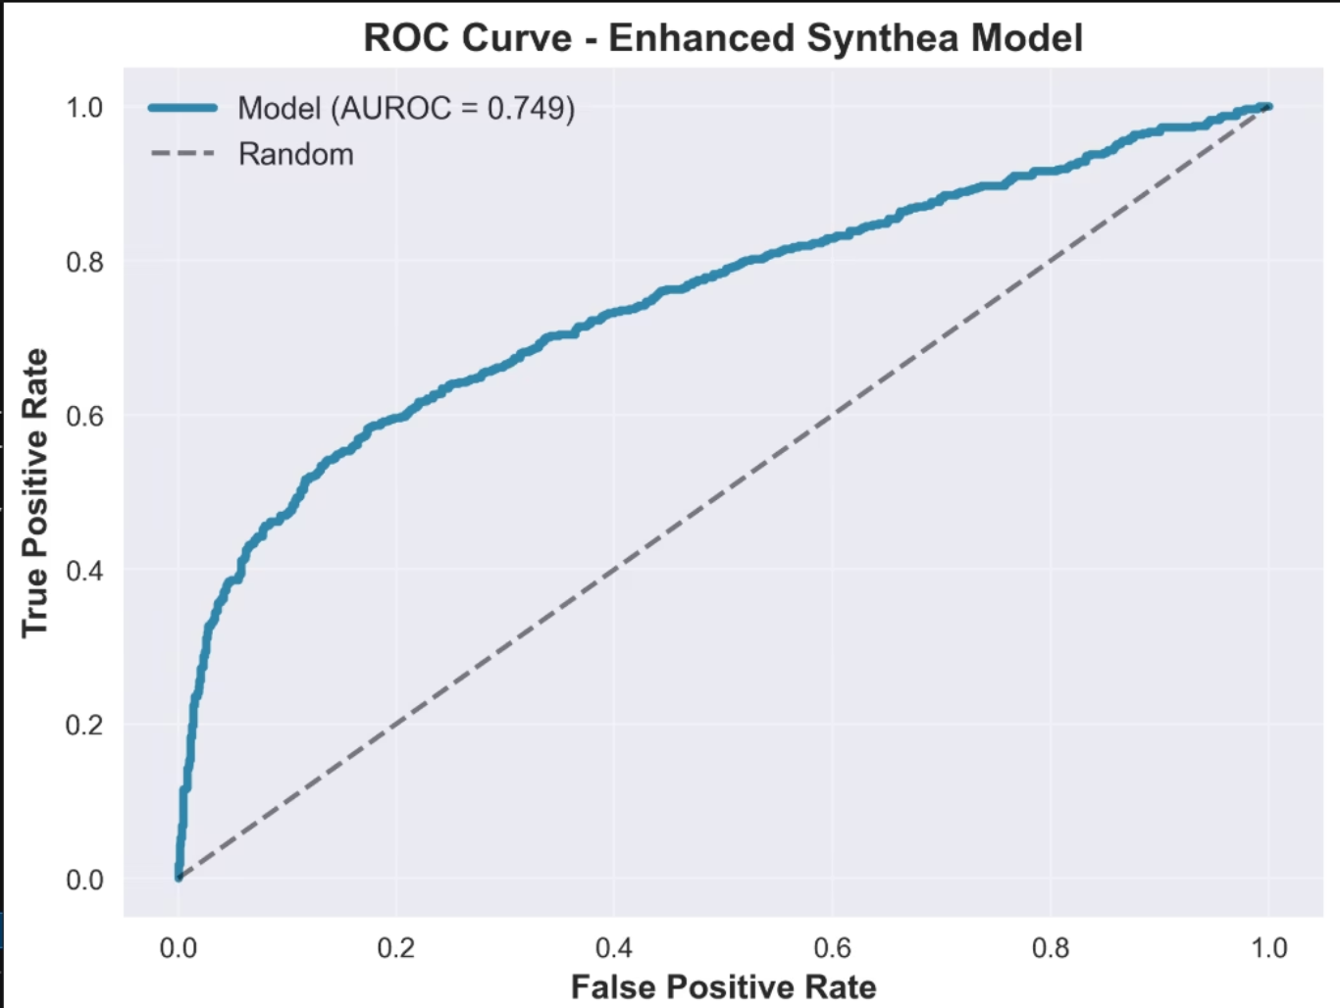
Exceptional Predictive Performance
Our model demonstrates outstanding performance in identifying at-risk patients, showcasing high accuracy and generalisability across diverse datasets.
MIMIC-IV (Real-World Data)
Synthea (Synthetic Validation)
0.99
0.99
0.75
0.73
AUROC
AUPRC
AUROC
AUPRC
Near-perfect discrimination and strong calibration, indicative of powerful predictive capability on real clinical data.
Robust generalisation to synthetic data, demonstrating the model's ability to perform well outside its training environment.

Slide 7
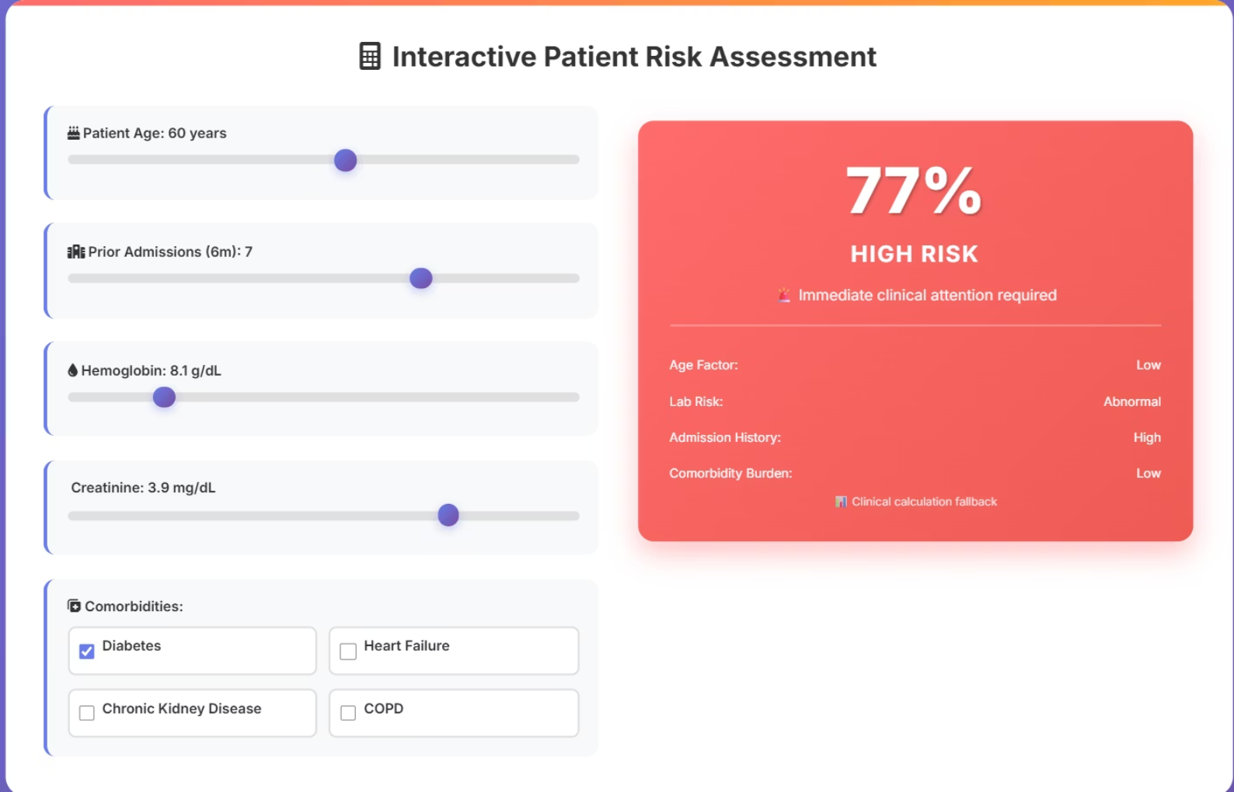
Interactive Prototype Dashboard
Translating Prediction into Action
Real-time Prediction
Instantly visualise risk scores based on adjustable patient parameters.
Explainable Risk Factors
Understand key drivers: age, abnormal labs, admission history, comorbidity burden.
Clinician-Friendly Interface
Designed for intuitive use, integrating seamlessly into clinical workflows.
Our interactive dashboard, built with Dash + Plotly, brings the power of our AI model directly to clinicians.

Slide 8






Impact, Limitations, & Future Directions
Our AI-driven engine holds immense potential for transforming chronic care, alongside clear next steps for broader implementation and impact.
Current Limitations
Primarily based on an ICU-focused dataset.
Significant Impact
Validation currently limited to synthetic data.
Earlier detection of clinical decline.
Enabling proactive, personalised care plans.
Next Steps
External validation with diverse real-world datasets.
Reduced hospital readmissions and healthcare costs.
Seamless integration with Electronic Health Records (EHR).
Incorporation of wearable device data & NLP on clinical notes.

